Slide 1
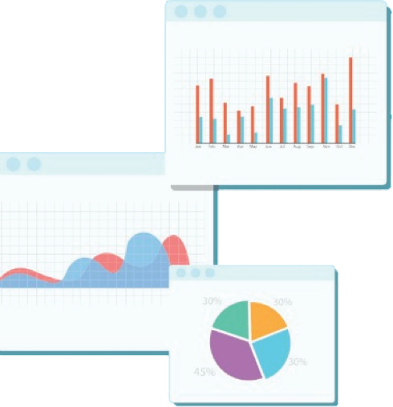

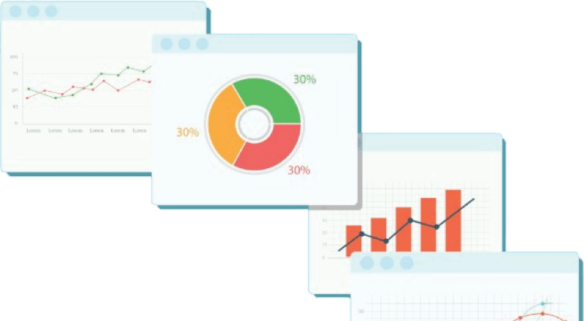
Welcome to Week 9
Lecture 2!
Data Science in Python &
Machine Learning

Slide 2
Today’s Agenda
Review unsupervised learning
Apply Kmeans clustering to improve a supervised model
Clustering Mini Hackathon in breakout rooms
Return to share findings (if time permits)

Slide 3
How is Unsupervised Learning
Different than Supervised Learning?
No target variable
No train test split
No X, y split

Slide 4
Using KMeans Clusters as a Feature in Supervised Learning
Clusters found with KMeans can be a feature.
KMeans performs feature extraction.
If we are using KMeans for analysis - No Train Test Split
If we are using KMeans for feature extraction for supervised learning we must use a train test split
kmeans.fit(X_train)
X_train[‘cluster’] = kmeans.predict(X_train)
X_test[‘cluster’] = kmeans.predict(X_test)

Slide 5
Code-a-Long
Combining Supervised and Unsupervised Learning
Melbourn Housing Data

Slide 6
Today’s Challenge
You will use the same data set (Melbourne Housing), but you have different problem.
You are tasked with dividing these properties into groups for your marketing team.
If time permits we will reconvene in the main room for a 2 minute “lightning pitch” with the goal of convincing the class that your clustering results will be useful to the client.
Note, an example of part b of this challenge to “improve a supervised learning model” was already addressed, so you are only focusing on task a!

